Slide 1

LOGISTIC REGRESSION

Slide 2
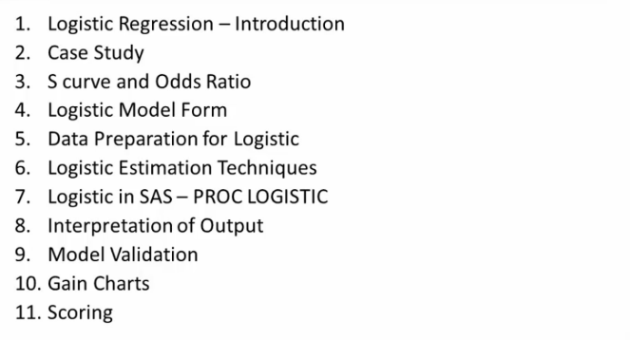
Module II – Logistic Regression

Slide 3
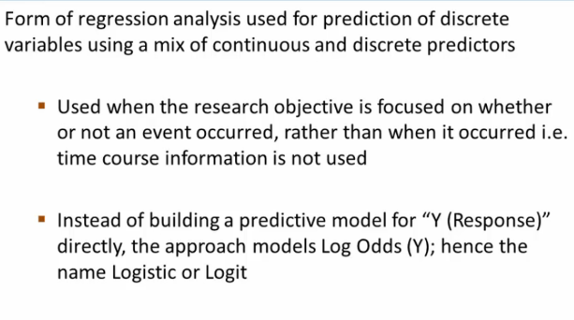
Logistic Regression

Slide 4
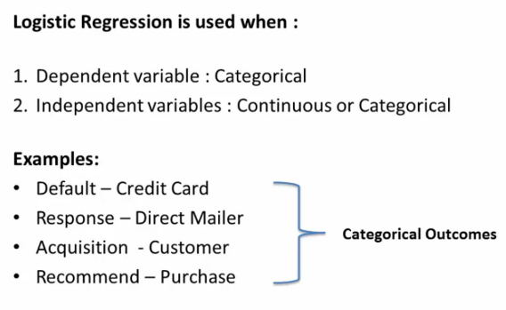
Logistic Regression

Slide 5
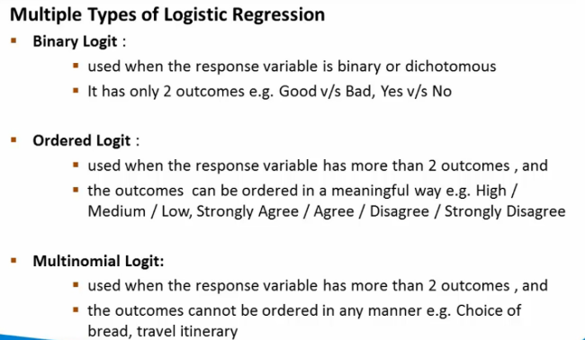
Logistic Regression

Slide 6
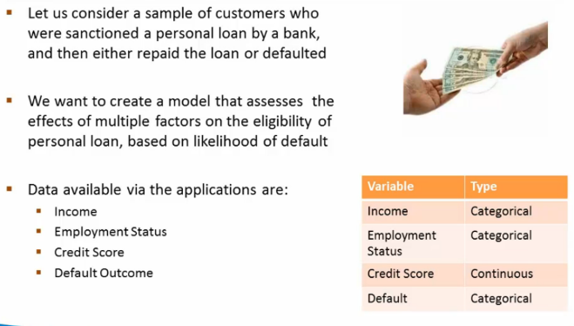
Logistic Regression – Case Study

Slide 7
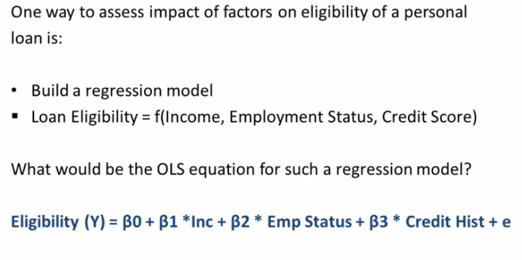
Logistic Regression – Case Study

Slide 8
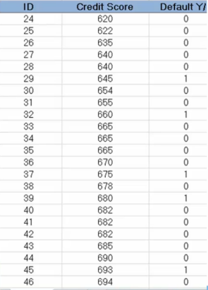
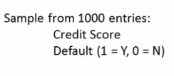
Logistic Regression – Case Study

Slide 9
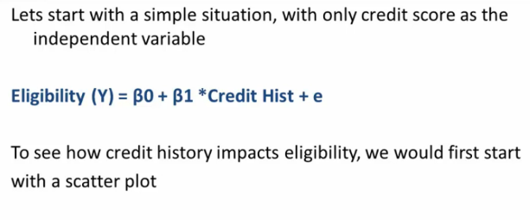
Logistic Regression – Case Study

Slide 10
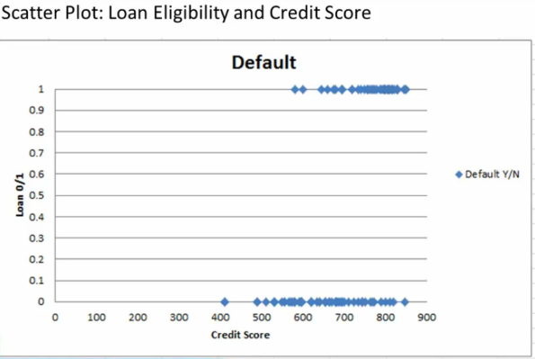
Logistic Regression – Case Study

Slide 11
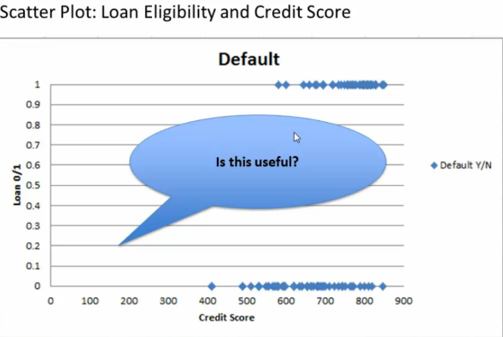
Logistic Regression – Case Study

Slide 12
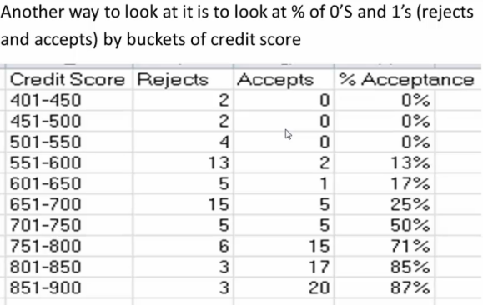
Logistic Regression – Case Study

Slide 13
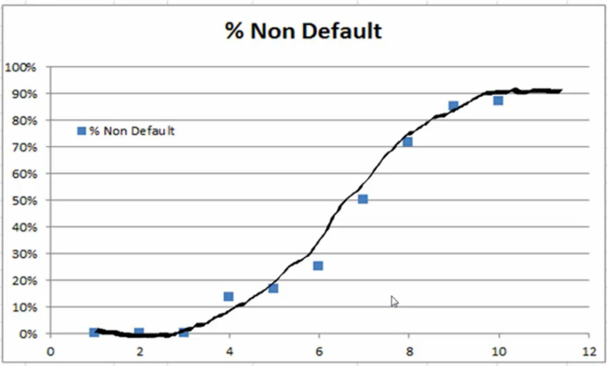
Logistic Regression – Case Study

Slide 14
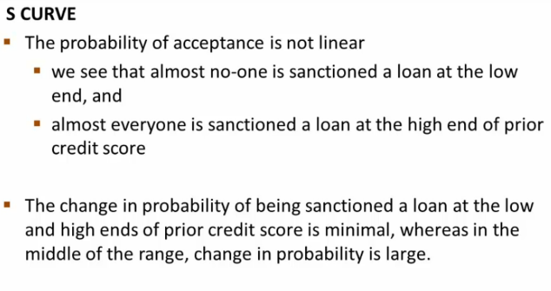
Why Logistic Regression ?

Slide 15
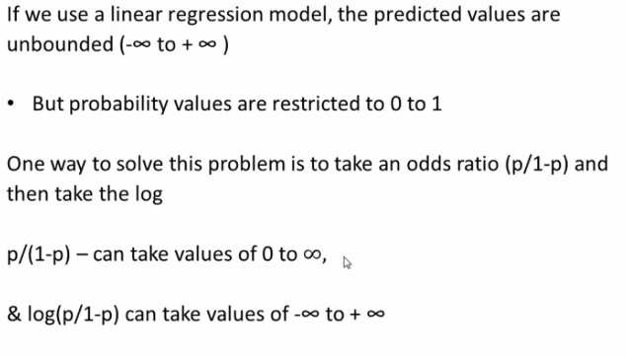
Logistic Regression – Case Study

Slide 16
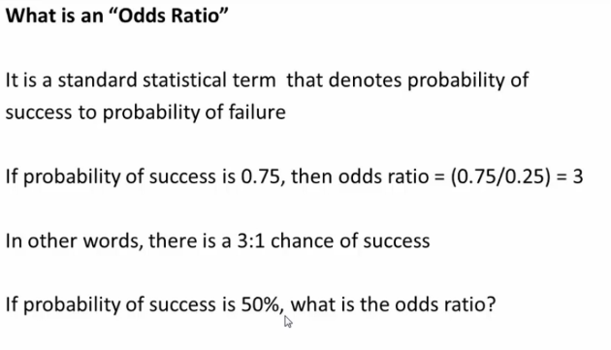
Logistic Regression – Case Study

Slide 17
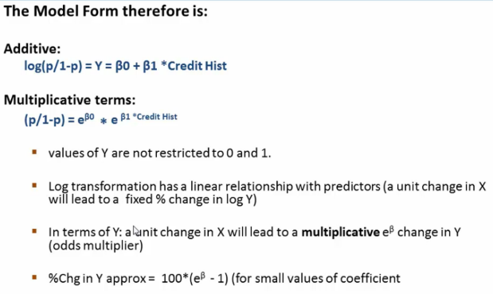
Logistic Regression model Form

Slide 18
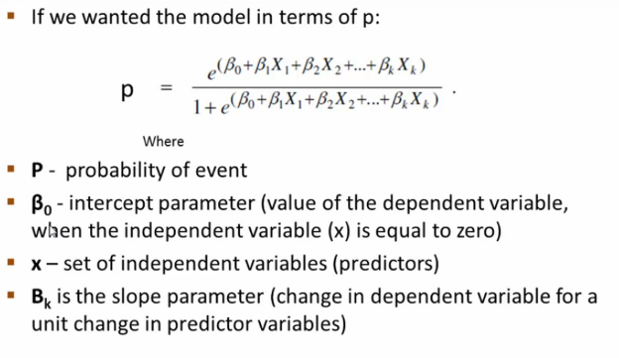
Logistic Regression model Form

Slide 19
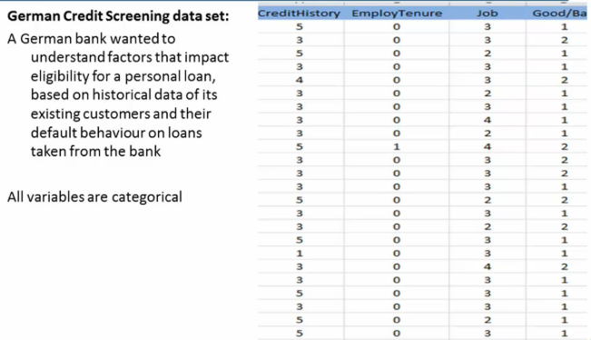
Logistic Regression model Form

Slide 20
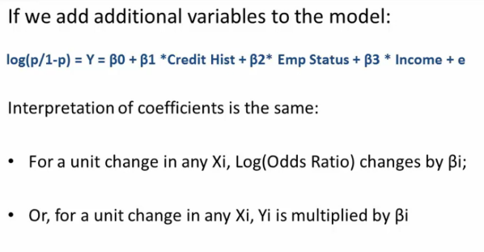
Logistic Regression model Form

Slide 21
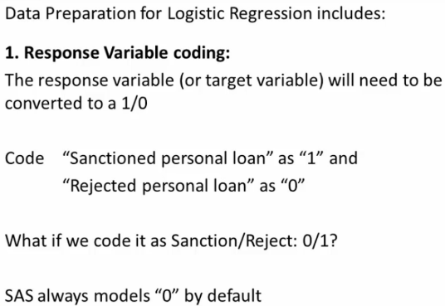
Logistic Regression - Data Preparation

Slide 22
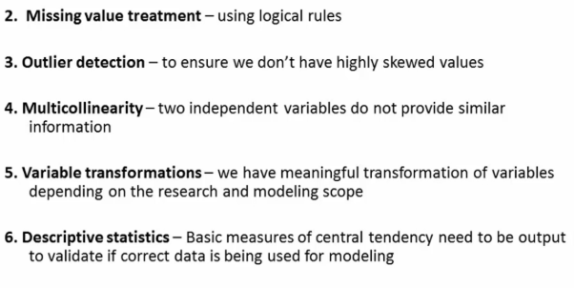
Logistic Regression - Data Preparation

Slide 23
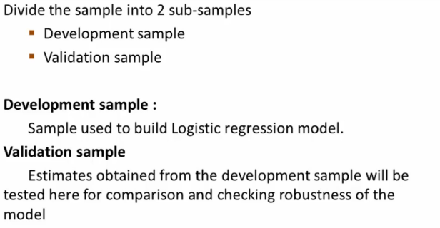
Logistic Regression - Data Partition

Slide 24
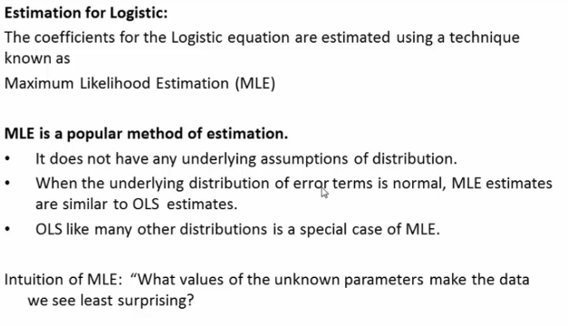
Logistic Regression - Parameter Estimation

Slide 25
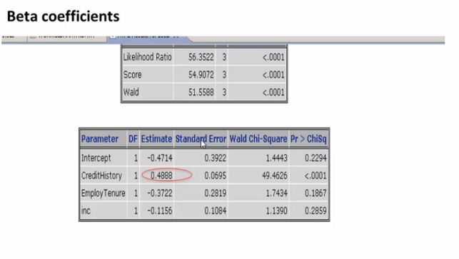
Logistic Regression – Key Statistics

Slide 26
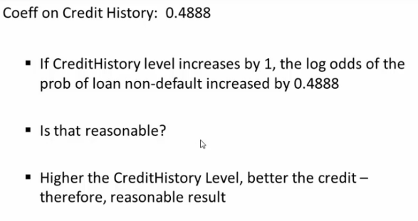
Logistic Regression – Key Statistics

Slide 27
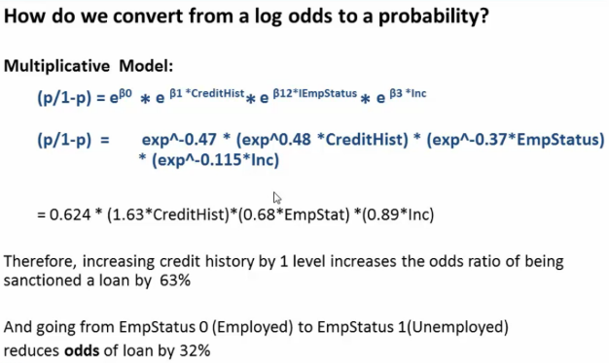
Logistic Regression

Slide 28
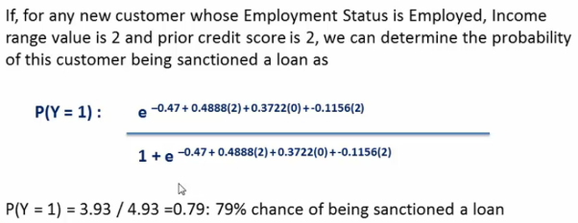
Logistic Regression

Slide 29
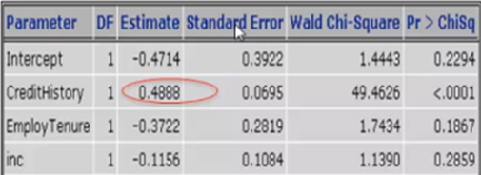
Logistic Regression – Significant of Independent variable

Slide 30
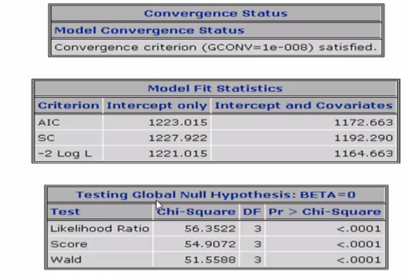
Logistic Regression – Model Fit Statistics

Slide 31
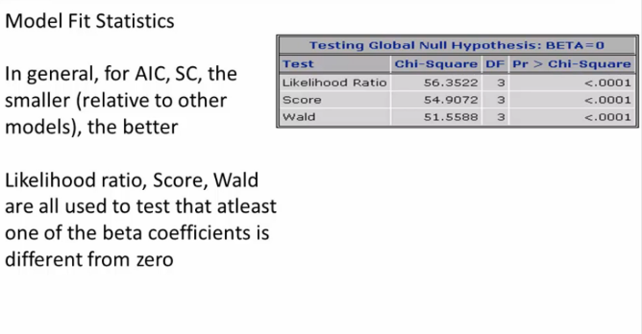
Logistic Regression – Model Fit Statistics

Slide 32
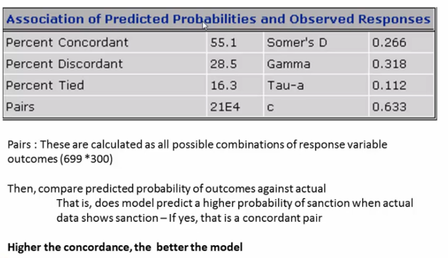
Logistic Regression – Model Fit Statistics

Slide 33
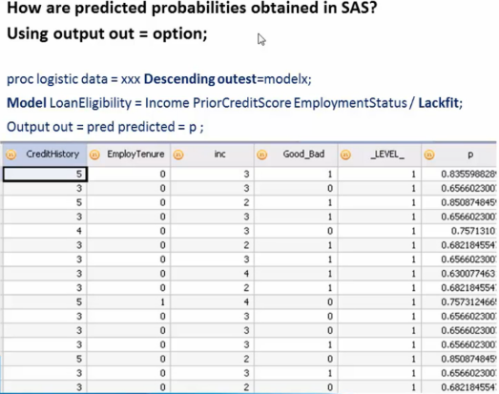
Logistic Regression – Predicted Probabilities

Slide 34
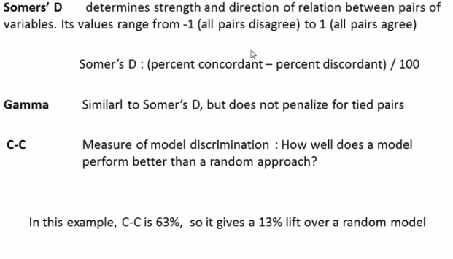
Logistic Regression – Model Fit Statistics

Slide 35
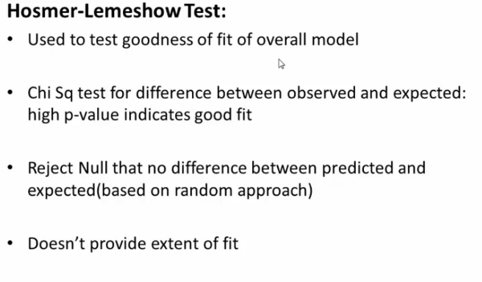
Logistic Regression – Model Fit Statistics

Slide 36
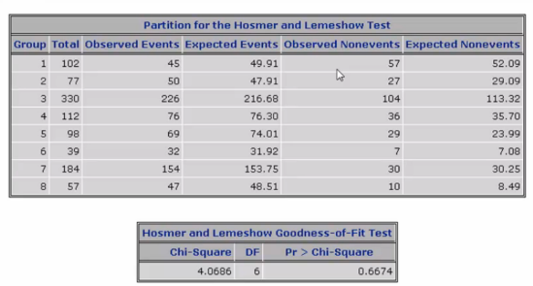
Logistic Regression – Model Fit Statistics

Slide 37
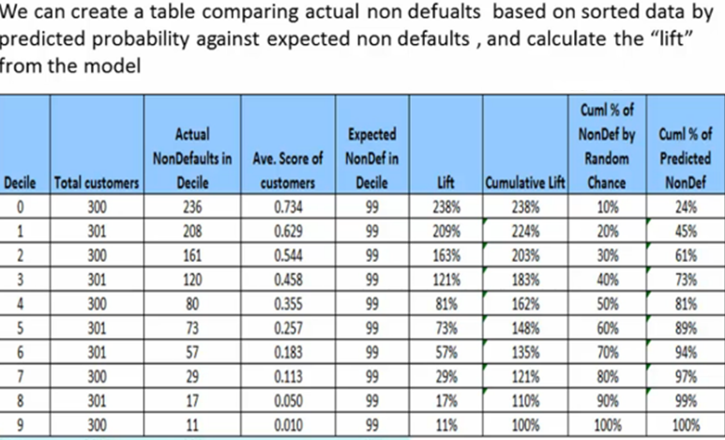
Logistic Regression – Gain/Lift Chart

Slide 38
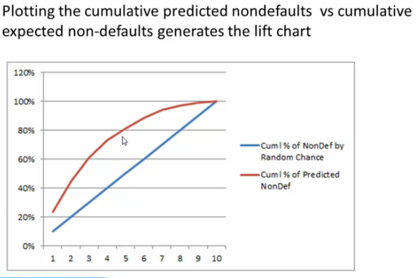
Logistic Regression – Gain/Lift Chart
http://themainstreamseer.blogspot.in/2012/07/understanding-and-interpreting-gain-and.html

Slide 39
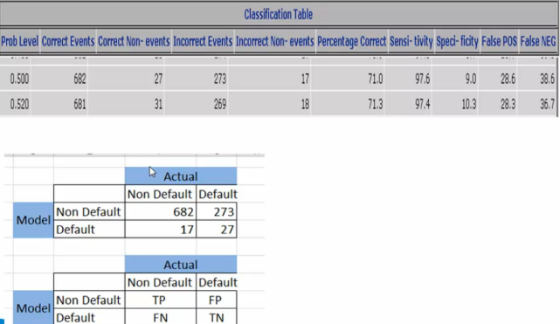
Logistic Regression – Model Fit Statistics

Slide 40
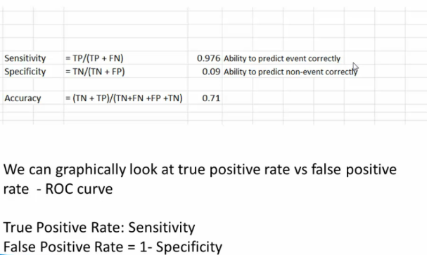
Logistic Regression – Model Fit Statistics

Slide 41
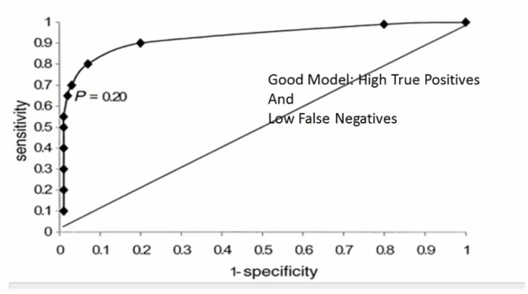
Logistic Regression – Model Fit Statistics
ROC Curve

Slide 42
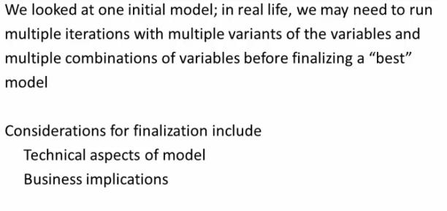
Logistic Regression – Model Finalization

Slide 43
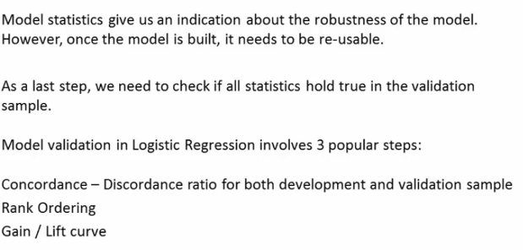
Logistic Regression – Model Validation

Slide 44
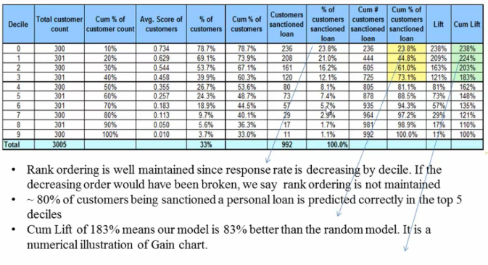
Logistic Regression – Rank Ordering

Slide 45
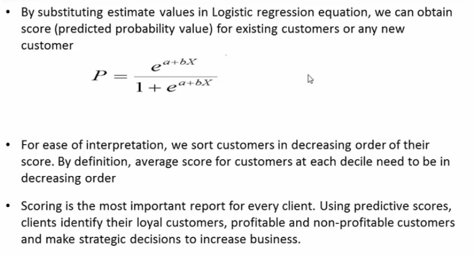
Logistic Regression – Scoring

Slide 46
Summary
Logistic Regression used when dependent variable is categorical
Logistic Regression is Non linear and its S shape curve
General form of Logistic Regression in Log(P/1-P)=Bo+B1+B2+……..Bn
Regression coefficient is estimated using MLE (Linear regression coefficient is estimated using OLS)
Wald’s Test is used to check significant of Independent variables
Logistic Regression Model Validations are – Concordance Rank Order,
Lift/Gain curve,
Hosmer Lemshow Test
Calssfication table
ROC Curve

